Slide 1










Collaboration and Licensing
Opportunity Guidelines
Organised by:
www.medfit-event.com
Supported by:
@MedFIT_event
MedFIT Event

Slide 2

Objectives
  Provide the guidance you need to effectively communicate your technology.
  Encourage you to think through the aspects of your project the same way partners will be assessing it.
  Help you to effectively promote your project to the audience composed of investors, potential partners…
  Remember that you will be evaluated on several major sets of criteria:
Asset maturity
Roadmap readability
Degree of security of the patent (FTO, patentability…)
Differentiation
Market access potential
Collaboration capacity (receive financing / attract industrial partners)

Slide 3





Pitch DNA
DO
Cite reports, articles, testimonials to give credibility to your claims
Think market, not science
Mind the time
Metrics matter
Focus Focus Focus!
Remember the audience hears your proposal for the first time
Convey a clear differentiator
Show that your team is the best one
Showing is better than telling
Be clear, precise and keep it simple
DON’T
Go over time
Assume the audience immediately understand your innovation
Be too technical
Hide risks
Use acronyms
Oversell / Make promise you can’t hold
Add too much details

Slide 4

Requirements
The visual presentation:
Number of slides: 6 slides is ideal. Remember: less is more!
Add pictures, graphs: Showing is better than telling
The oral presentation:
Practice:
  Nail down the flow
  Practice before in front of an audience, listen to the feedback
Time: This is a 5-minute pitch, so make sure that you keep your presentation concise and stay focused
Arrival: Arrive 10 minutes before your presentation
Make sure you have and convey ONE key take-away per slide!

Slide 5






Structure of the Pitch
INTRODUCTION
OPPORTUNITY
COMPETITION
SOLUTION
THE ASK
TEAM
Introduction: Define the project in ONE sentence.
Team: Identify the laboratories involved and explain their competencies.
Opportunity: Establish the need and the size of the market. Problem statement/unmet needs.
Solution: Demonstrate how you will solve the problem and validate your differentiation, the innovativeness of the concept.
Competition: Identify the competitors, validate the differentiators.
The Ask: Ask for the order and outline - what you need to make your project successful.

Slide 6
Introduction / Team
1 slide => 1 min
INTRODUCTION
Tell us: IN ONE SENTENCE define the project
Concisely state your core value proposition, including targeted market
Tell which unique benefit you will provide to which customers
What need will you address?
Key objective:
Everyone should know the basic idea and value proposition of the project
TEAM
Tell us: The Laboratories involved – crisp and relevant experience/competencies on key players
Key objective:
Show the audience that there is a core group working on the project

Slide 7


Opportunity / Market
1 slide => 1 min
Tell us:
  Problem statement:
    To which unmet needs does your project answer
    Explain why does the problem persist
Market:
  Identify the market size
  How does the market change/grow over time?
Key objective:
Establish the need of your project’s solution and convince the audience that solving the problem is important
Describe the problem, convey the pain
(Clear) Problem
(Large) Market
+
= (Great) Opportunity
Show how there is a big market for your solution

Slide 8

Solution / Competition
2 slides => 2 min
Tell us:
  Demonstrate your solution/technology and its technical specification - What are you offering to whom?
    Explain your innovation / IP (protection and valuation strategy)
    Explain how you will keep your promise (clinical studies, lab scales…)
    Explain your target product profile
  Explain the technology and the IP strategy, then relate your technology to medical practice
  Where do you play in the environment outlined above?
  Validate your differentiation and USP
    What is your differentiator or unique competitive advantage?
    Quantify 3 to 4 key benefits you provide
  How and why is the new solution better?
Key objective:
Help the audience to understand:
  How you will solve the problem
  Who you are competing with
  Why you have a better technology or solution than others
  How you can win

Slide 9
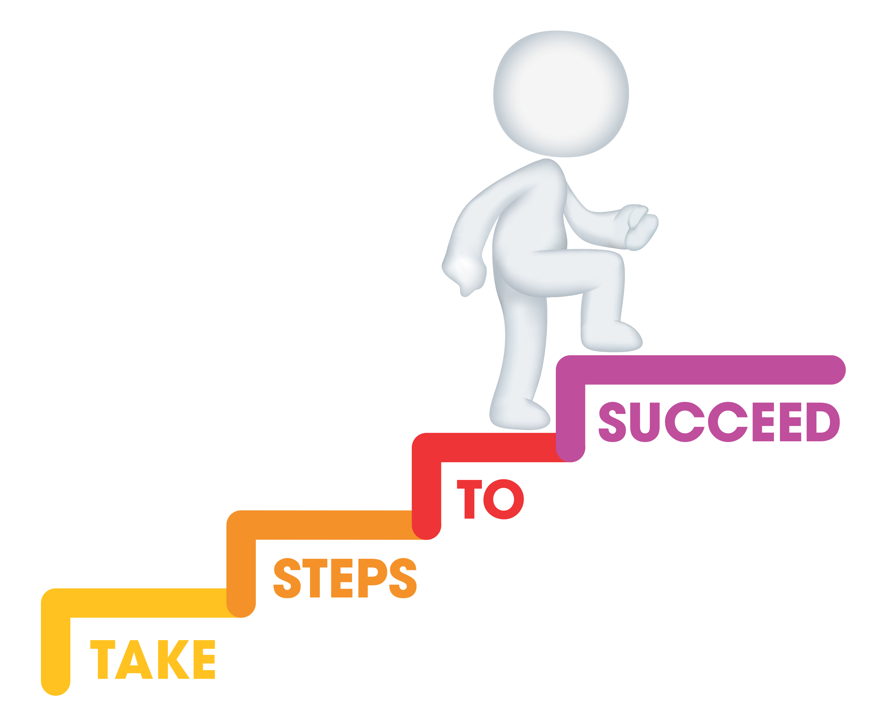
The Ask
1 slide => 1 min
Tell us:
State your development status
Tell us what are your next steps and what type of alliance or investment you seek to achieve
Key objective:
Outline what you need to make your project a success
The audience wants to see that you are hitting milestones and that you are asking is necessary to make your project a success
Keep in mind that your potential future partners will be listening!

Slide 10
Contact
1 slide => Closure
Contact details
First name:
Family name:
Company name:
Email address:
Phone number:

