Slide 1
Start-up Slams
Guidelines
Organised by:
www.medfit-event.com
Supported by:
@MedFIT_event
MedFIT Event

Slide 2
Objectives
Provide the guidance you need to effectively communicate your business idea.
Encourage you to think through the aspects of your business the same way VCs will be assessing it.
Help you to sell your idea to the audience composed of investors, potential partners…
Remember that you will be evaluated on 3 major sets of criteria:
The impact of the innovation
The implementation capacity
The quality of your pitch
A start-up is, at the core, an idea.
And an idea is only as good as its communication.

Slide 3
Pitch DNA
DO
Set realistic goals
Mind the time
Metrics matter
Focus Focus Focus!
Remember the audience hears your proposal for the first time
Convey a clear differentiator
Show that your team is the best one
Showing is better than telling
Be clear, precise and keep it simple
DON’T
Go over time
Assume the audience immediately understand your innovation
Be too technical
Hide risks
Use acronyms
Oversell / Make promise you can’t hold
Add too much details

Slide 4
Requirements
The visual presentation:
Number of slides: 6 slides is ideal. Remember: less is more!
Add pictures, graphs: Showing is better than telling
The oral presentation:
Practice:
Nail down the flow
Practice before in front of an audience, listen to the feedback
Time: This is a 5-minute pitch, so make sure that you keep your presentation concise and stay focused
Arrival: Arrive 10 minutes before your presentation
Make sure you have and convey ONE key take-away per slide!

Slide 5
Structure of the Pitch
INTRODUCTION
OPPORTUNITY
COMPETITION
BUSINESS MODEL
SOLUTION
THE ASK
TEAM
Introduction: Define the company/business/project in ONE sentence.
Team: Identify the core group of talent who can execute on the next development steps of the company.
Opportunity: Establish the need and the size of the market. Problem statement/unmet needs.
Solution: Demonstrate how you will solve the problem and validate your differentiation, the innovativeness of the concept.
Competition: Identify your competitors, validate your differentiators.
Business Model: Explain what your business model is, show what you have accomplished so far, and make future forecasts.
The Ask: Ask for the order and outline - what you need to make your business successful.

Slide 6
Introduction / Team
1 slide => 1 min
INTRODUCTION
Tell us: IN ONE SENTENCE define your company/business/project
Concisely state your core value proposition, including targeted market
Tell which unique benefit you will provide to which customers
What need will you address?
Key objective:
Everyone should know the basic idea and value proposition of the company
TEAM
Tell us: Management – crisp and relevant experience/competencies on key players:
Board of directors / Key future hires / Panel of advisors (if applicable)
Key objective:
Show the audience that there is a core group that believes in the company and can execute the next milestones

Slide 7
Opportunity / Market
Tell us:
Problem statement:
To which unmet needs does your project answer
Explain why does the problem persist
Market:
Identify the market size
How does the market change/grow over time?
Key objective:
Establish the need of your company’s solution and convince the audience that solving the problem is important
1 slide => 1 min
Describe the problem, convey the pain
(Clear) Problem
(Large) Market
+
= (Great) Opportunity
Show how there is a big market for your solution

Slide 8
Solution / Competition
Tell us:
Demonstrate your solution - What are you offering to whom?
Explain your innovation / IP (protection and valuation strategy)
Explain how you will keep your promise (clinical studies, lab scales…)
Explain your target product profile
Where do you play in the environment outlined above?
Validate your differentiation and USP
What is your differentiator or unique competitive advantage?
Quantify 3 to 4 key benefits you provide
How and why is the new solution better?
Key objective:
Help the audience to understand:
How you will solve the problem
Who you are competing with
Why you have a better product or solution than others
How you can win
1 slide => 1 min

Slide 9
Business Model
Tell us:
How you will make money:
What does your business model look like?
Own programme development
Partnering
What are your financing sources
How will you provide an exit for investors?
M&A
IPO
Potential partnerships and collaborations
Own commercialisation
What milestones are you going to realistically hit: what is your roadmap?
What is you go-to market strategy?
Key objective:
Explain how you are going to implement your innovation and to make return on the investment
1 slide => 1 min

Slide 10
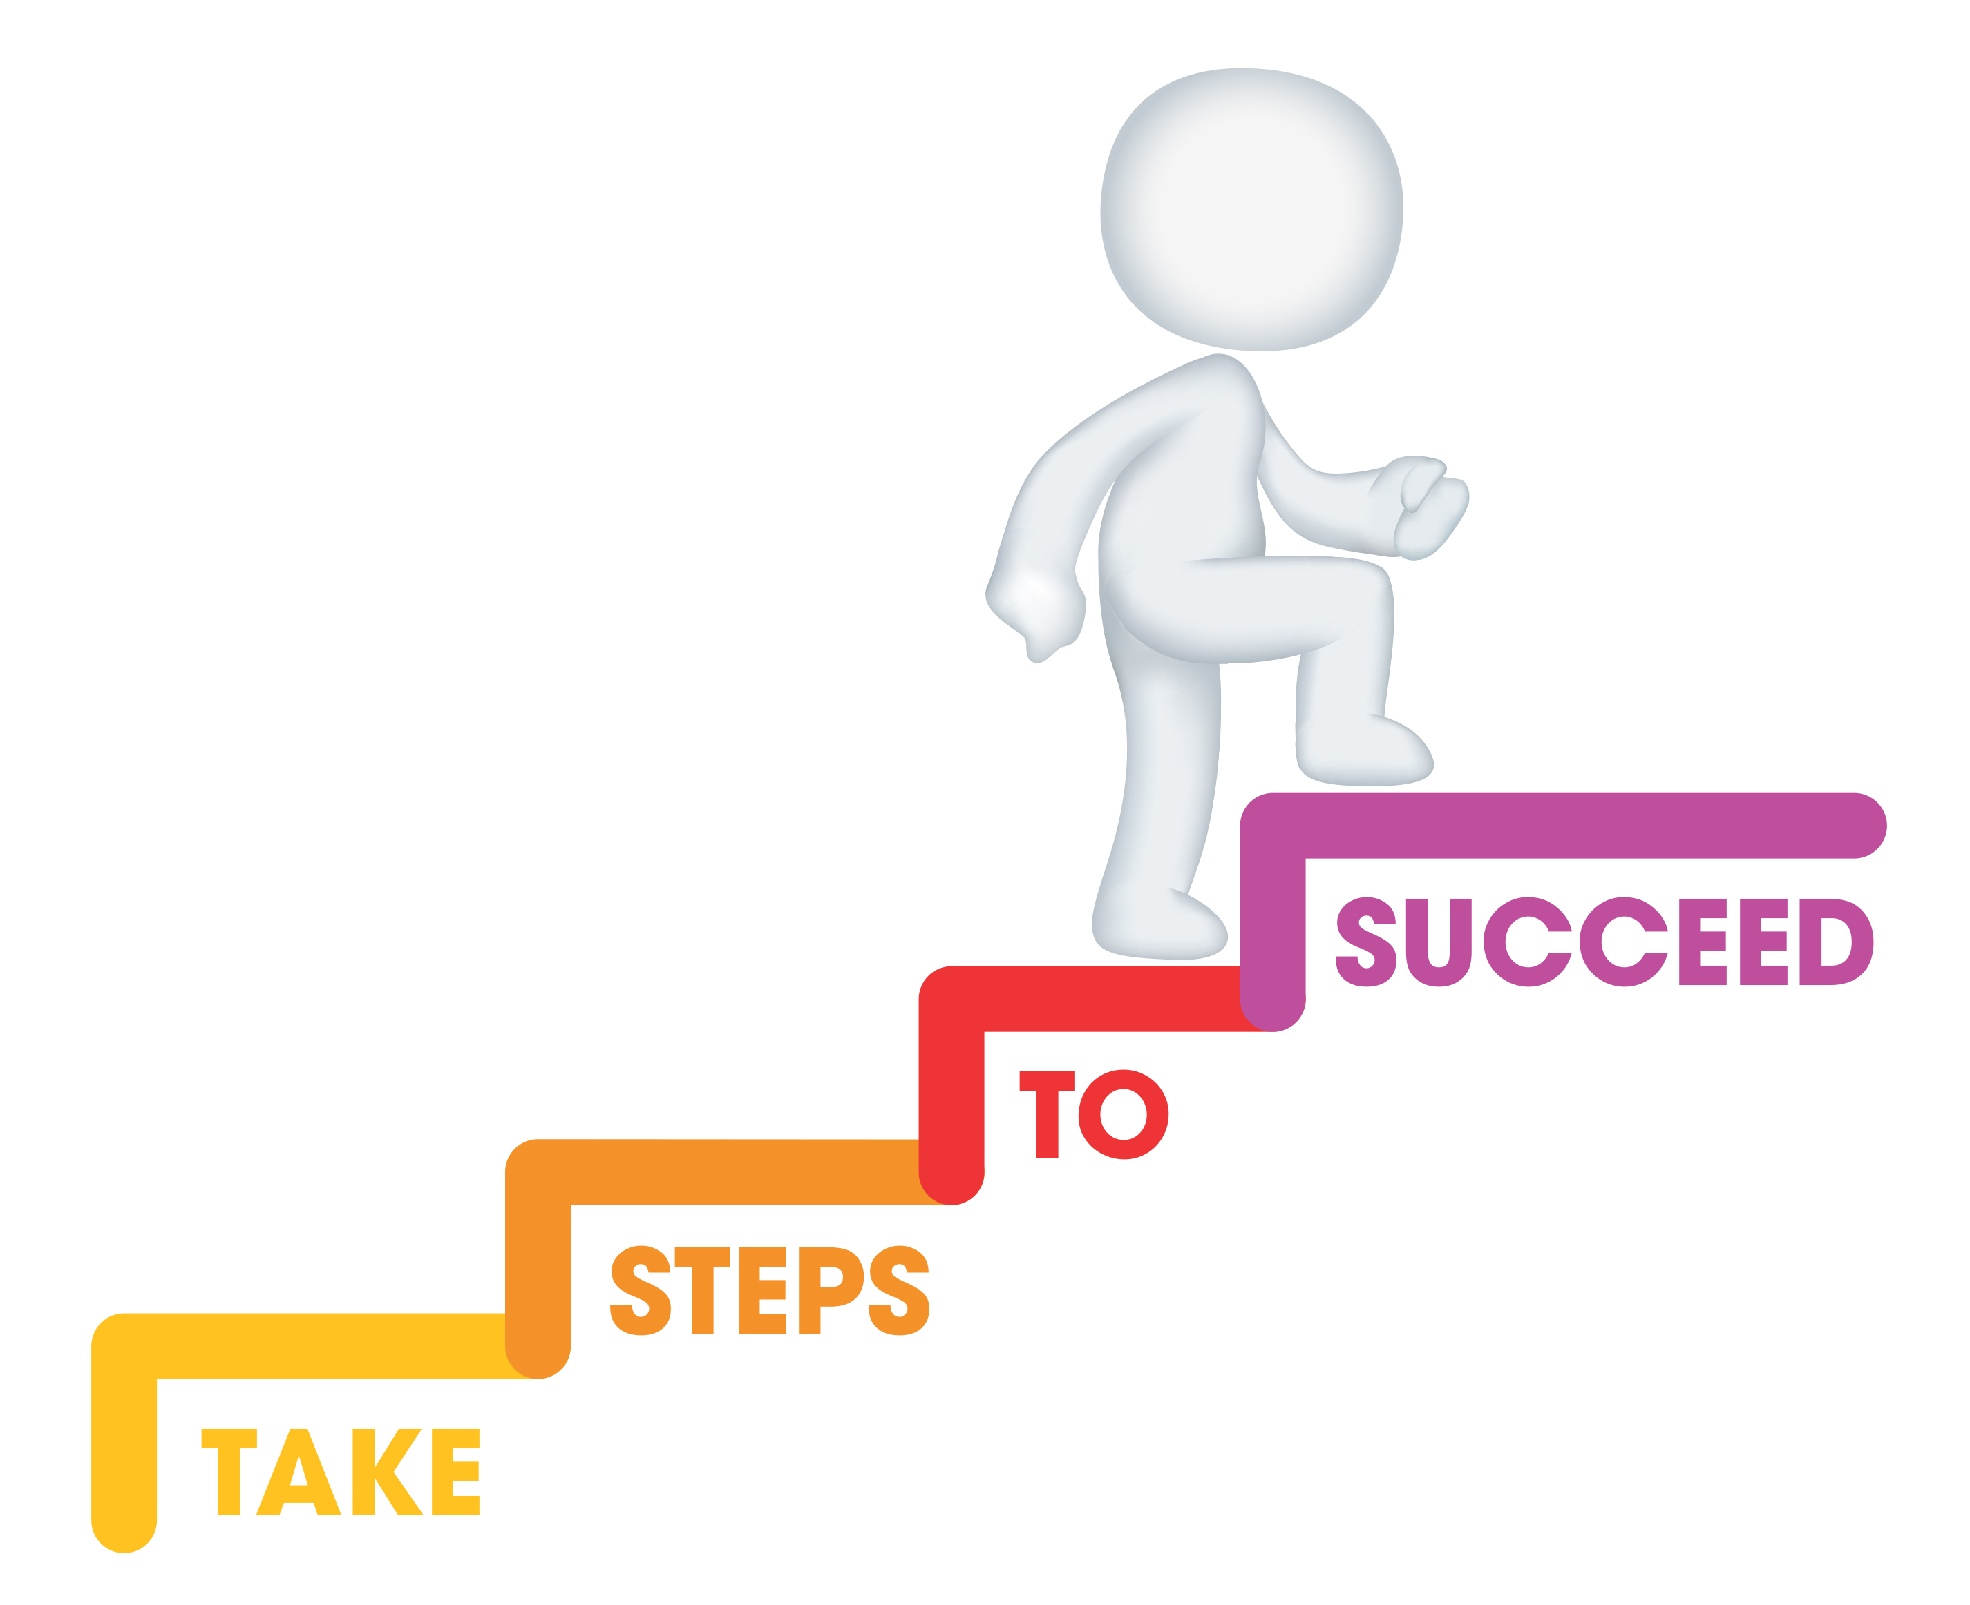
The Ask
1 slide => 1 min
Tell us:
Your valuation expectations
The amount you are looking to raise
The milestones you will hit with the new capital
Your ‘bum’ rate
Key objective:
Outline what you need to make your business a success
Investors want to see that you are hitting milestones and that you are asking for the right amount of money; the amount should not be arbitrary, explain by using numbers that you are asking for the right amount of money
Keep in mind that your potential future partners will be listening!

Slide 11
Contact
1 slide => Closure
Contact details
First name:
Family name:
Company name:
Email address:
Phone number:

